Slide 1

INSTAGRAM USER ANALYTICS
Deriving actionable insights by using SQL

Slide 2
PROJECT DESCRIPTION:
The project is all about to analyze Instagram user data to give insights that can drive decision making for both marketing strategies and business growth.
This project focuses on two areas of analysis: A) Marketing Analysis.
B) Investor Metrics.
The main purpose of analyzing user data is to understand user behavior,improving growth and overall user experience.

Slide 3
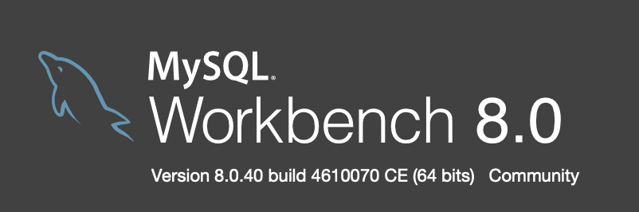
TECH-STACK USED:
SOFTWARE: MySQL Workbench 8.0.40
I used MySQl Workbench software because it can run multiple queries at a time compared to mysql server and also It is easy to use and extract the queries in detailed way.
OPERATING SYSTEM: MacOS
My device is MacOs.I have used it as it is stable and efficient

Slide 4
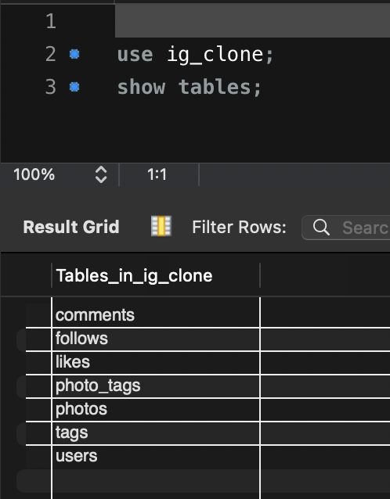
APPROACH:
To do the project,The team has given the dataset about the instagram with the database name “ig_clone”.I have loaded the given database into my MySql Workbench and used the command(show tables) to check the available tables.

Slide 5
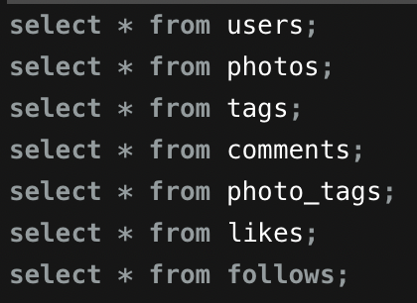
To know about the data in more detailed way I have checked all the tables data by using command containing select keyword.
By the commands,I have seen the table structures which made my task of selecting the correct tables for query easy.

Slide 6
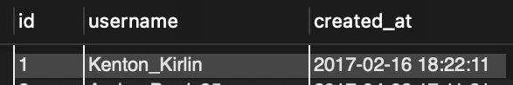
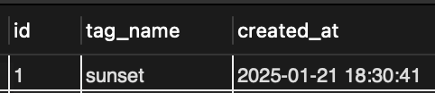
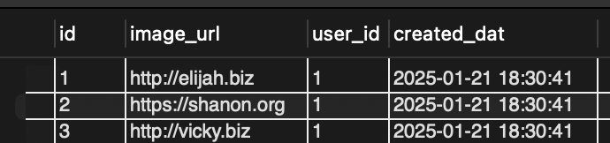

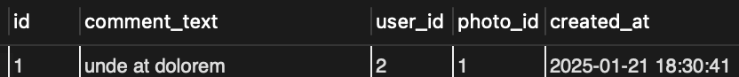
TABLE STRUCTURES:
1.USERS
3.TAGS
2.PHOTOS
4.PHOTO_TAGS
5.COMMENTS

Slide 7
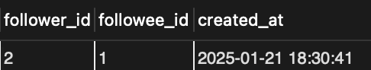
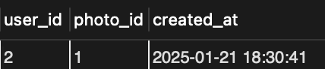
TABLE STRUCTURES:
6.FOLLOWS
7.LIKES

Slide 8
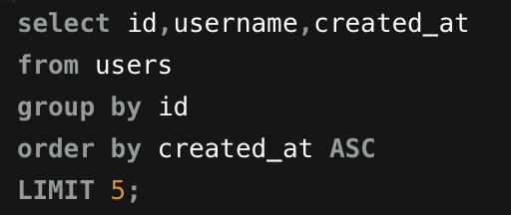
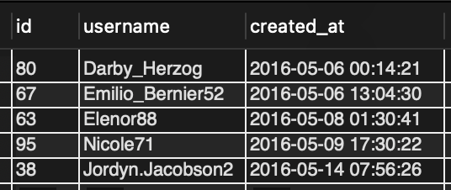
MArketing analysis:
1.Loyal User Reward: Identify the five oldest users on Instagram from the provided database.
To solve the given task,I have used the user table which contains created_at details,Because by calculating the date of registration we can know the oldest users.I used LIMIT keyword to get only 5 users.
QUERY:
OUTPUT:

Slide 9
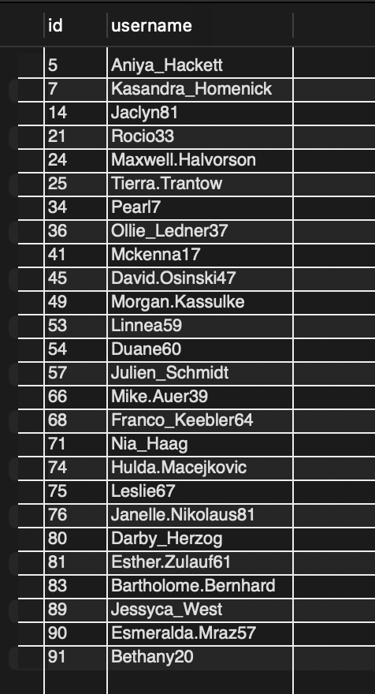
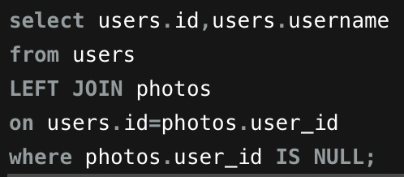
2.Inactive User Engagement: Identify users who have never posted a single photo on Instagram.
To solve the given task,I have used the users table and photos table.By the concept of Left Join I matched the all users and users who kept photos(user_id).Then by the condition photos.user_id IS NULL(i have printed the users who haven’t posted photos.
QUERY:
OUTPUT:

Slide 10
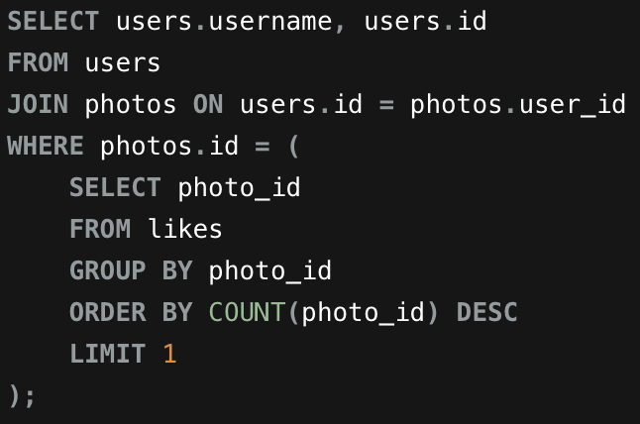
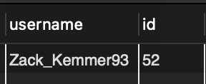
3.Contest Winner Declaration: The team has organized a contest where the user with the most likes on a single photo wins.Determine the winner of the contest and provide their details to the team.
To solve the given task,I have used users,photos and likes tables.Used the concept of JOIN to eliminate the users who didn’t keep any photo,then from the likes table I have calculated repetition of photo_id by count() aggregate function and retrieved the highest liked photo_id to match with the user_id and finally determined the winner.
QUERY:
OUTPUT:

Slide 11
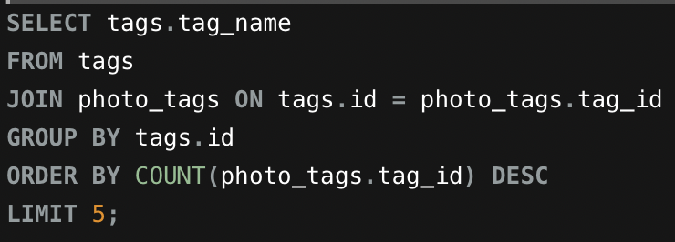
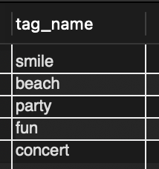
4.Hashtag Research: Identify and suggest the top five most commonly used hashtags on the platform.
To solve the given task,I have used the tags table and photo_tags table.by the concept of Join on tags & photos, I have eliminated the unused tags and counted the tags used order by their names using count() function.then retrieved the most used tagname by using LIMIT as 5 and orderby sorting as DESC.
QUERY:
OUTPUT:

Slide 12
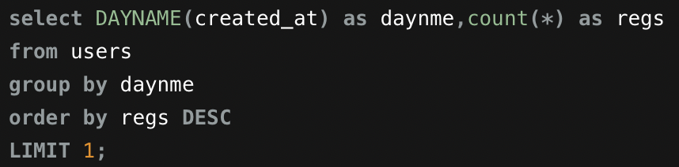
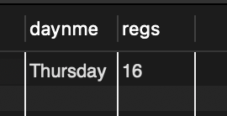
5.Campaign Launch: Determine the day of the week when most users register on Instagram. Provide insights on when to schedule an ad campaign.
To solve the given task,I have used the users table.The registration data is in users data in created_at column.I have used DAYNAME function to convert the given date of registration to day and counted the most repeated day by count() in descending order with LIMIT 1 and found the day as “THURSDAY” On this day the partners can launch the ads.
QUERY:
OUTPUT:

Slide 13
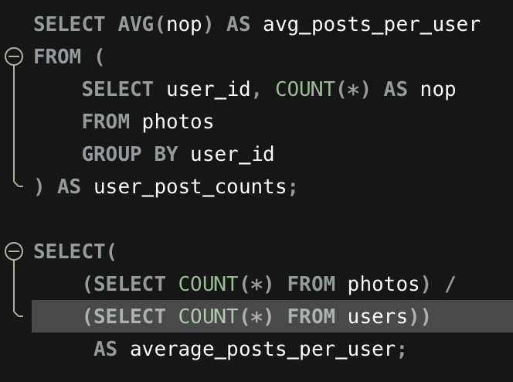
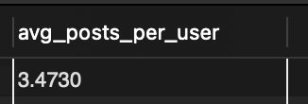
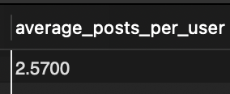
INVEStor metrics:
1.User Engagement: Calculate the average number of posts per user on Instagram. Also, provide the total number of photos on Instagram divided by the total number of users.
To solve the given task,I have used the avg() aggregate function to find average number of posts and and also found count(photos) divided by count(users)
QUERY:
OUTPUT:

Slide 14
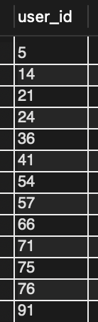
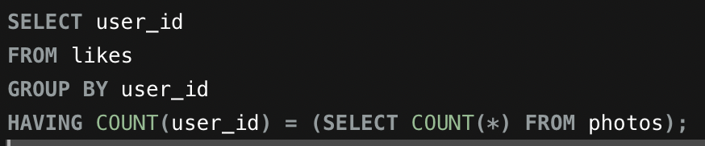
2.Bots & Fake Accounts: Identify users (potential bots) who have liked every single photo on the site, as this is not typically possible for a normal user.
To solve the given task,I used the likes and photos table,by which I retrieved the user_id who liked all photos by comparing (count of likes by particular user = count of total photos from photos table).By this we can detect the bots and fake accounts.
OUTPUT:
QUERY:

Slide 15
INSIGHTS:
The insights from the project are from both the analysis:Marketing and Investor metrics.
Loyal User Reward: I found out the oldest users.
Inactive user behaviour:I found out the users who didn’t keep single photo.
Content Winner Declaration:I found out the user whose photo got most likes to declare the winner for contest.
Hashtag Rewards: I found out the most used hashtag.
Campaign launch:I found out the day when most users register to launch ads of partner companies.
User Engagement:I have calculated the average number of posts per user to provide benchmark for user activity levels.
Bots & Fake accounts: I have found the users(bots or fake)by checking who liked all the photos.

Slide 16
RESULT:
By the Project,I have analyzed Instagram user data and extracted the actionable insights by given questions.
I also had a great practice on MySQL concepts like Join, Subqueries,Aggregate functions,special keywords like DESC,ASC,LIMIT,ORDER BY,GROUP BY.
This project had good impact on empowering marketing campaigns by identifying user behaviour.It improved my skills of MySQL and way of analysing the data.

Slide 17
THANK YOU

